Slide 1
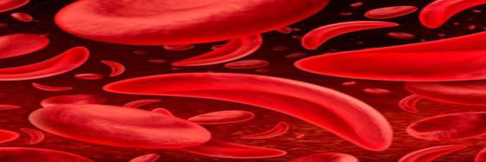
WORLD SICKLE CELL DAY June 19th 2026
Theme: "Closing the Survival Gap:
Equity in Sickle Cell Disease Care

Slide 2

Understanding Sickle Cell Disease
Theme: "Know Your Genotype, Protect Your Future"
@ Niger Delta Science School
Preventive Healthcare Initiative
Sustainable Approach to Preventive Healthcare

Slide 3
Learning Objective
What is Sickle Cell Disease?
Differentiate between genotype patterns (AA, AS, AC, SS, SC).
Understand how SCD is inherited.
Know the importance of genotype testing.

Slide 4
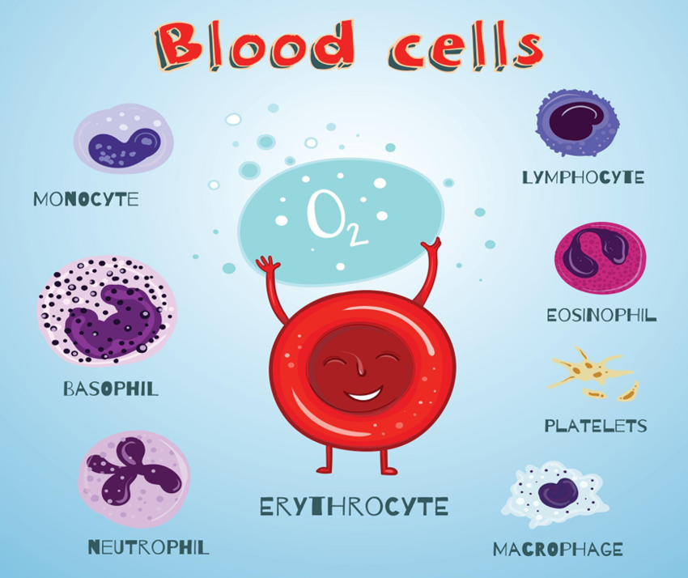

Slide 5
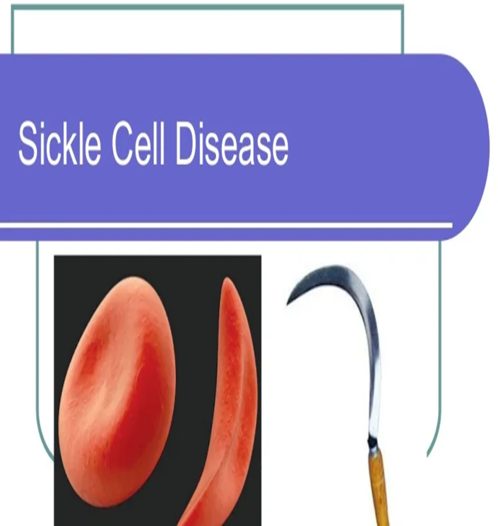
What is Sickle Cell Disease?
Sickle Cell Disease (SCD) is an inherited blood disorder caused by a change (mutation) in the Haemoglobin gene (HbS)

Slide 6
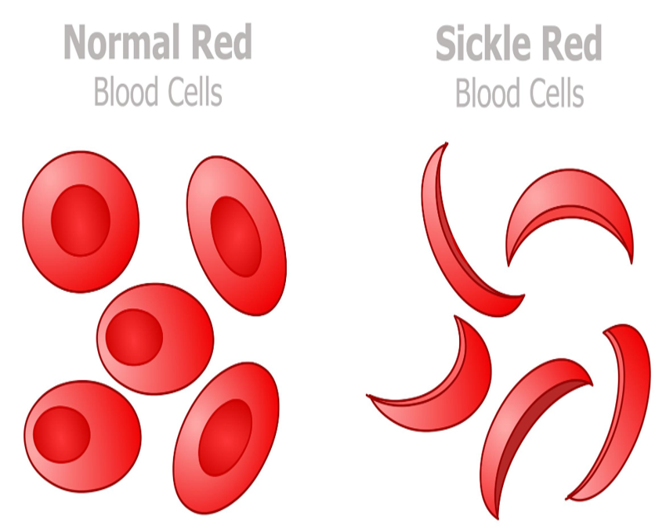

Slide 7
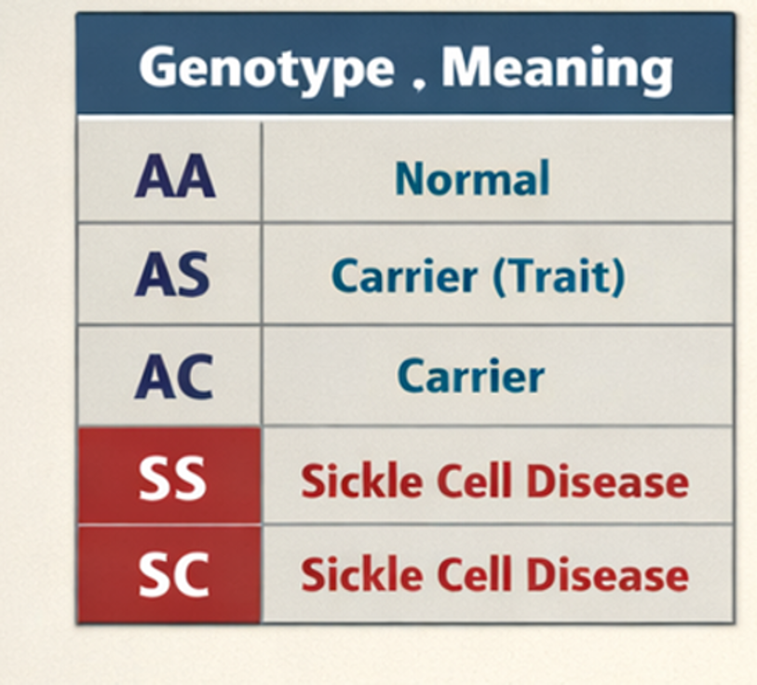
How is sickle cell Disease inherited
A person usually inherits one haemoglobin gene from their mother and one from their father.
A persons Genotype depends on the type of Haemoglobin gene inherited from the parents Eg-
HbA (Normal gene),
HbS (Abnormal gene)
Hb C (Abnormal)

Slide 8
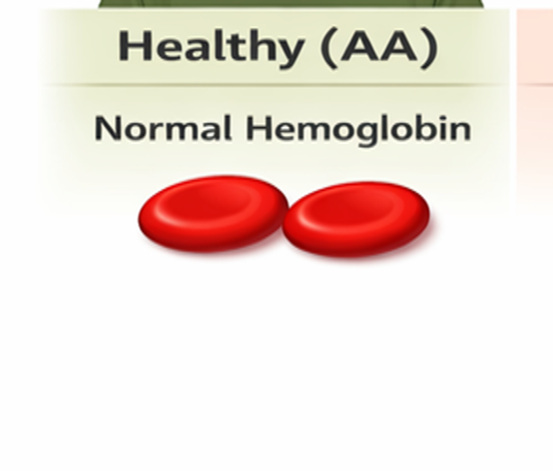
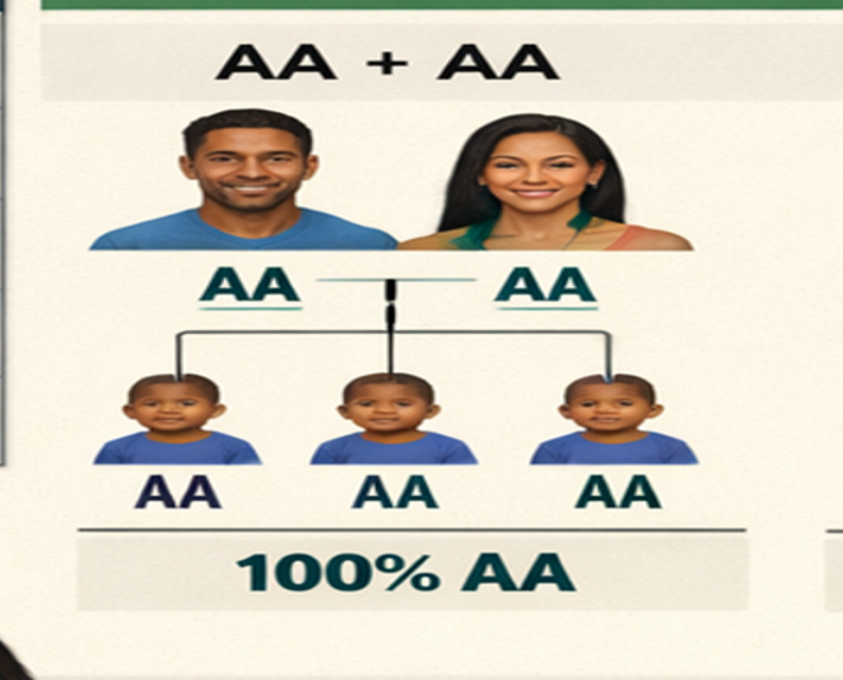
How Different Types of Genotypes of Genotypes are Inherited

Slide 9
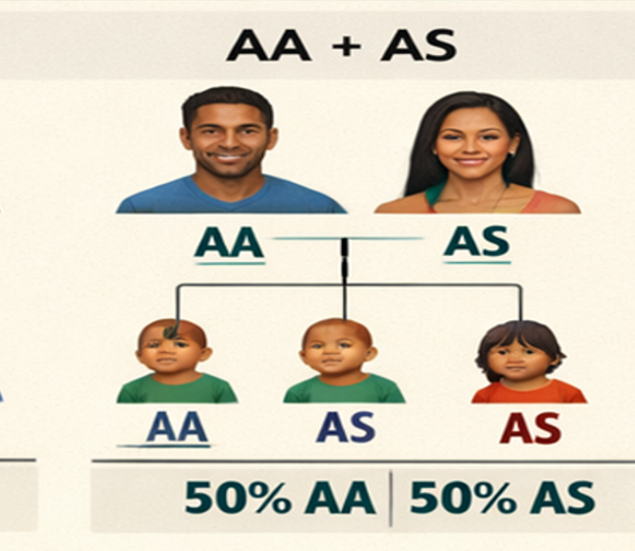
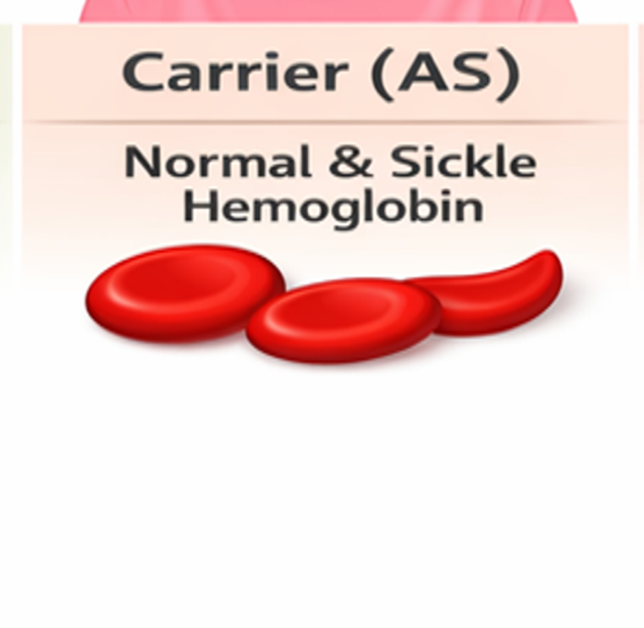

Slide 10
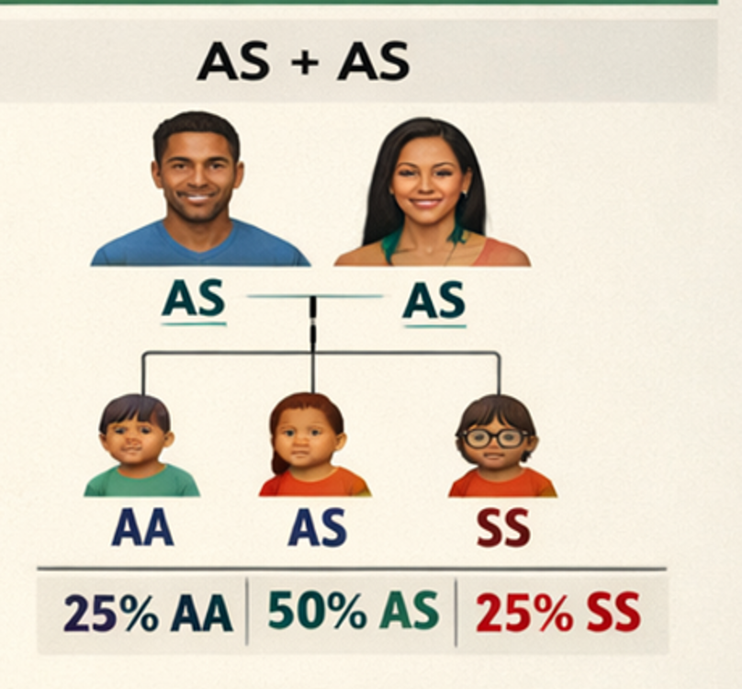
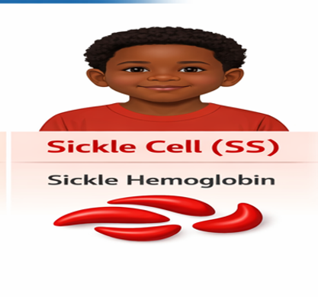
How Different Types Of Genotypes are Inherite

Slide 11

HHHpHow is sickle cell Disease inherited

Slide 12
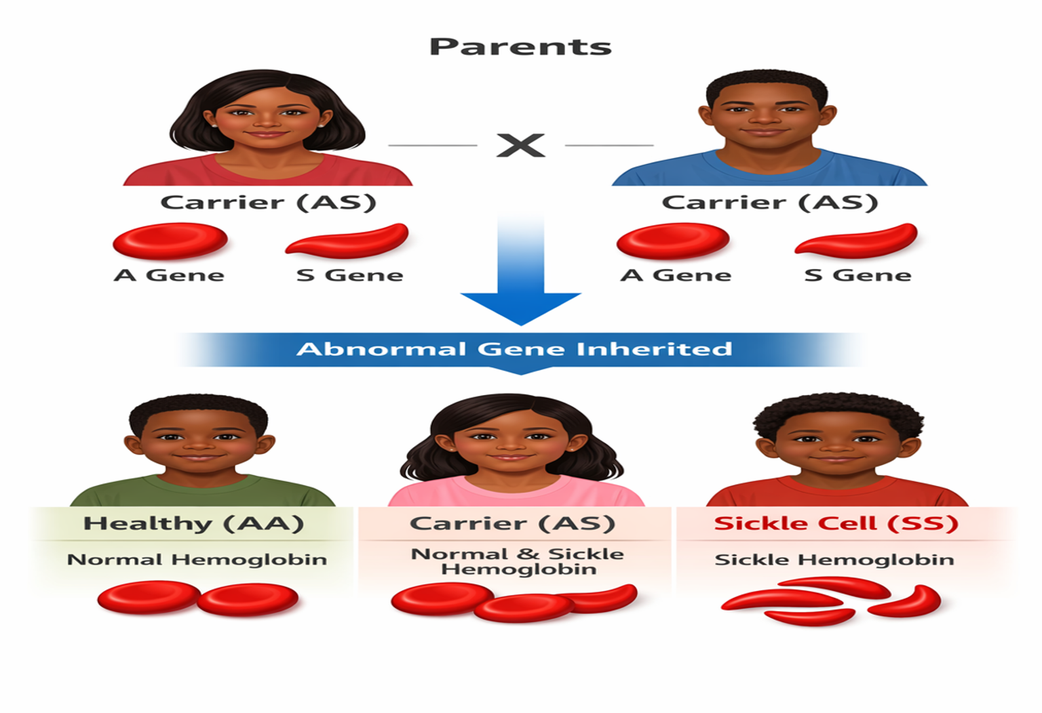
Effect of Sickle Cells in In The Body

Slide 13
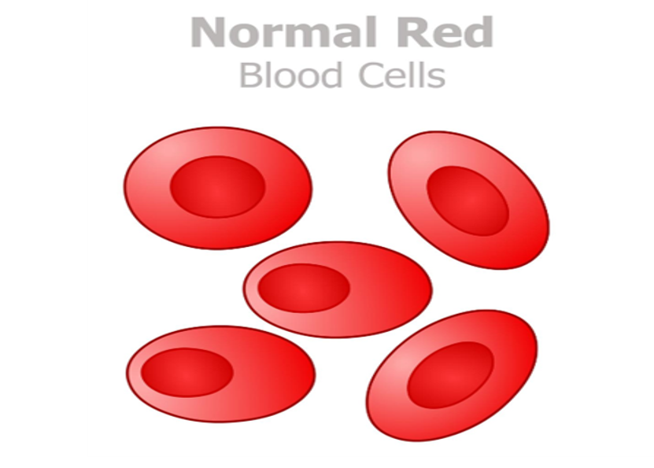
Normal Red Cells
Round
Flexible
Moves easily through
blood vessels.
Oxygen effectively

Slide 14

Sickle Red Blood Cells
Sickled or Crescent-shape
Hard
Sticky
Block blood vessels
Reduce blood flow and oxygen delivery to parts of the body."

Slide 15
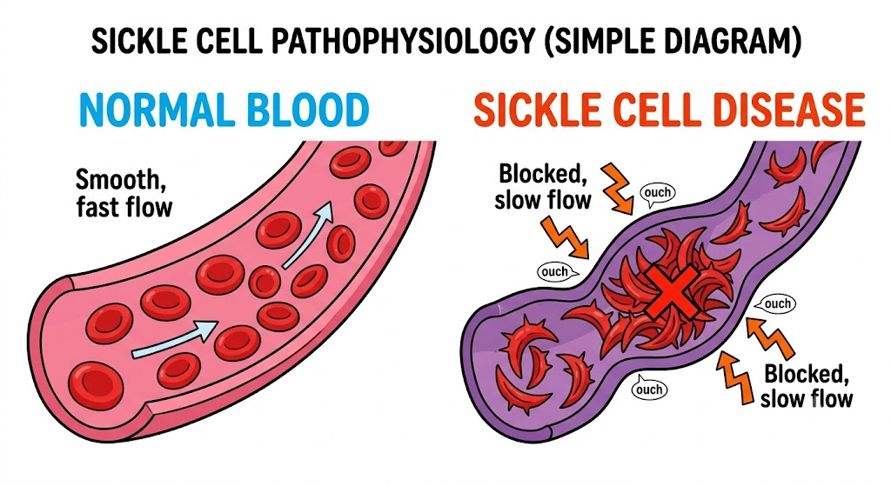

Slide 16
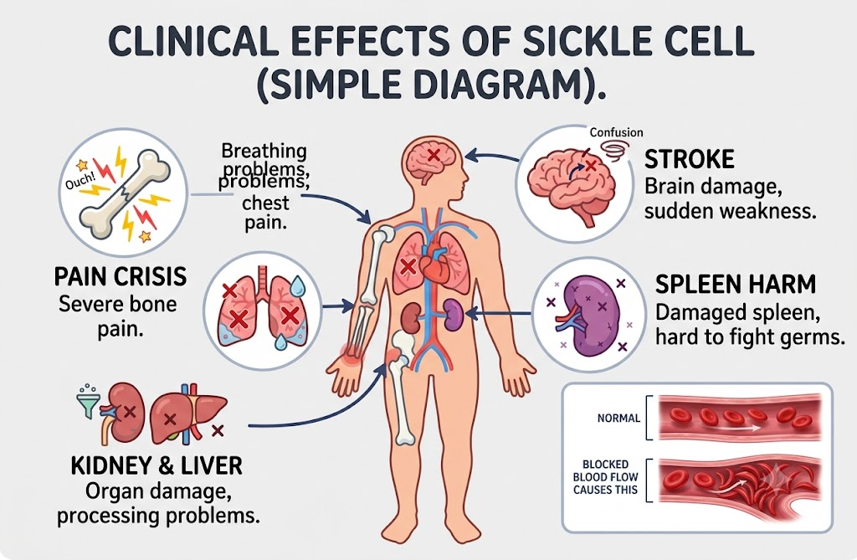
Effect of Sickle cell in the body

Slide 17
Effect of Sickle cell in the body
Anaemia (low blood level)
Tiredness and weakness
Increased risk of infections
Delayed growth in some children
School absenteeism

Slide 18
How Common is Sickle Cell Disease in Nigeria?
Nigeria carries the highest burden of sickle cell disease worldwide.
About 25% of Nigerians (1 in 4) have the sickle cell trait (AS).
Nearly 150,000 babies are born every year with sickle cell disease.
People living with sickle cell are true warriors, fighting daily to survive and thrive

Slide 19
Call to Action- Key Message
Know your genotype.
Encourage your family and friends to know theirs
Do not stigmatize people living with sickle cell disease.
Support classmates and peers living with SCD.

Slide 20

Thank you

Slide 21
